Slide 1
ADVANCED SEGMENT TREE
ASIS KUMAR ROUT
JEEUKRISHNAN KAYSHYAP MUKESH SIYAK NIRMAL KHEDKAR

Slide 2
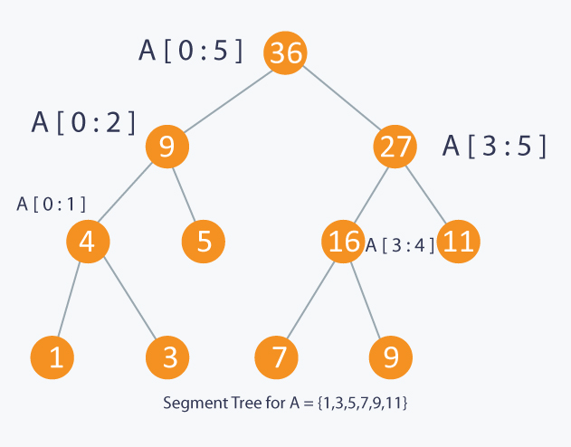
SEGMENT TREE
Segment tree is used for Range Query Operations.
It is represented in an array by converting it into a complete binary tree.
This is an example of a segment tree where each index stores a sum of range of elements.

Slide 3
MODIFICATIONS:-
Replacing node of a segment tree (which is a single element in simple segment tree) with an array.
Now, hash table, sets,heap, fenwick tree and even segment tree can be represented by an array.
So, We thought of replacing node of basic segment tree with these data structures.
We will be implementing
Segment tree with hash table.
2D Segment tree.

Slide 4
SEGMENT TREE WITH EACH NODE AS A SEGMENT TREE
The process to build a 2D segment tree is quite similar to process of building a 1D segment tree.
Only difference is that every node in a 2D segment tree is a 1D segment tree in itself, so it can be called a segment tree of segment trees.
2D segment tree consumes more space than a 2D Fenwick tree so it is mostly used for cases where 2D Fenwick tree can't be used.

Slide 5
SEGMENT TREE WITH EACH NODE AS A SEGMENT TREE (contd.)
Querying is also modified in same way. First, the 2D segment tree is searched for the 1D segment tree that satisfies the conditions along y-axis, then the 1D segment tree is travered for the node that satisfies conditions along x-axis.
For example, given a query for sub-matrix defined by 2 points (x1, y1), (x2, y2), first 2D segment tree searches for the segment tree bound by left = x1 and right = x2. The resultant segment tree is then searches for the node that satisfies left = y1 and right = y2.

Slide 6
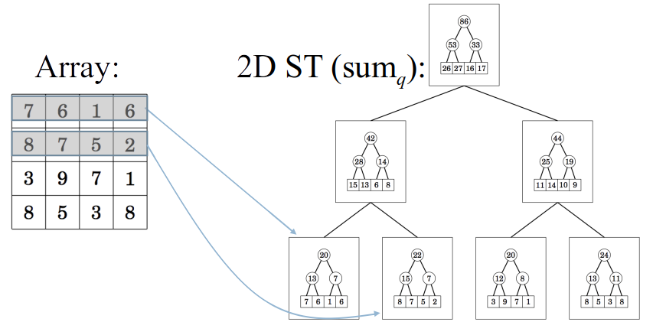

Slide 7
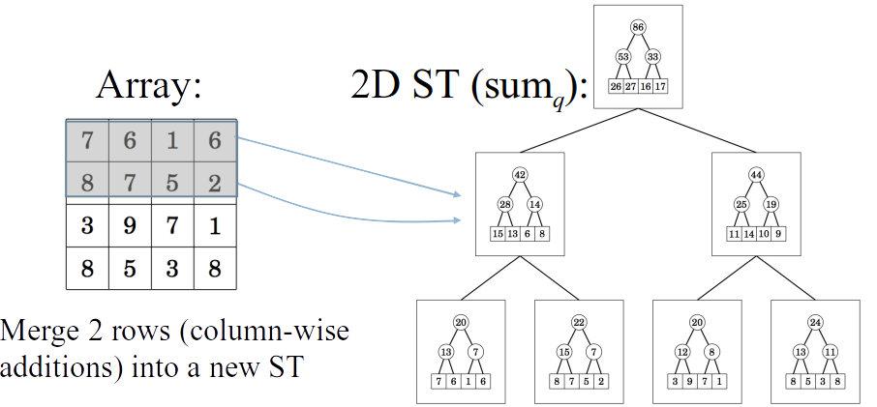

Slide 8
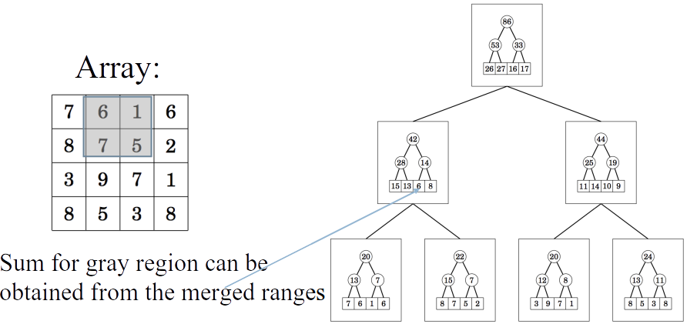

Slide 9
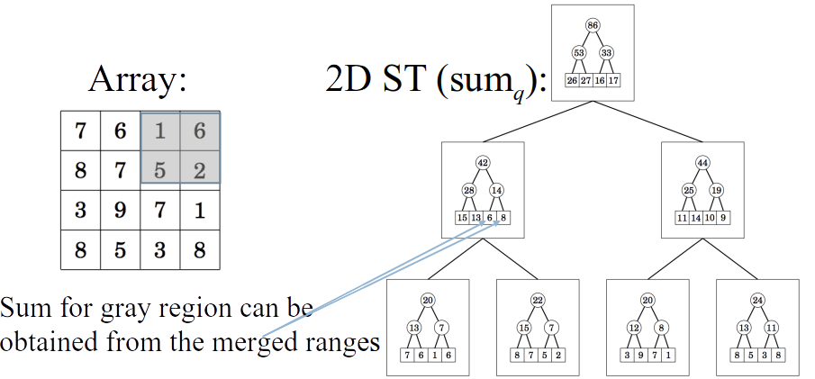

Slide 10
SEGMENT TREE WITH HASH MAP
We are given an array A of length N
We can perform two types of query in this array-
1.Update an element in the array i.e change the value of A[index] to X ( A[index]=X)
2.Find an element in a subarray (A[l...r]) which is dominating element .Dominating means that there is a number in the subarray that appears in the subarray at least as many times as one more than half of the length of the subarray.
BRUTE FORCE APPROACH-Store the count of elements in a Map of the subarray
Complexity-O(Q*N)

Slide 11
BUILD OPERATION
1 | 2 | 2 | 3 | 2 | 3
1 | 2 | 3
1 | 3 | 2
-1
1 | 2
1 | 2
2
3 | 2
2 | 1
1-6
3
1-3
4-6
1 | 2
1 | 1
2
1 1
3 | 2
1 | 1
-1
2
-1
3
1 1
3
1-2
4-5
6
3
2
1 1
1
1 1
2
2
11
1
3
11
2
3
2
1
5
4

Slide 12
UPDATE OPERATION
2 | 2 | 2 | 3 | 2 | 3
Update 1st element -2
2 | 3
4 | 2
1 | 2 | 3
1 | 3 | 2
-1
2
1 | 2
1 | 2
2
31
3 | 2
2 | 1
2
2
3
1-6
1-3
4-6
1 | 2
1 | 1
2
21
2
1 1
3 | 2
1 | 1
-1
2
-1
3
1 1
2
3
1-2
4-5
6
3
2
1 1
1
1 1
2
2
1 1
2
11
1
2
3
11
2
3
2
1

Slide 13
QUERY OPERATION
1 | 2 | 2 | 3 | 2 | 3
Query Operation- (2-5)
1 | 2 | 3
1 | 3 | 2
-1
1 | 2
1 | 2
2
3 | 2
2 | 1
1-6
3
1-3
4-6
1 | 2
1 | 1
2
1 1
3 | 2
1 | 1
-1
2
-1
3
1 1
3
1-2
4-5
6
3
2
1 1
1
1 1
2
2
11
1
3
11
2
3
2
1

